Slide 1
Fine Tuning LLMs
Hailiang Chen
HKU Business School
The University of Hong Kong

Slide 2
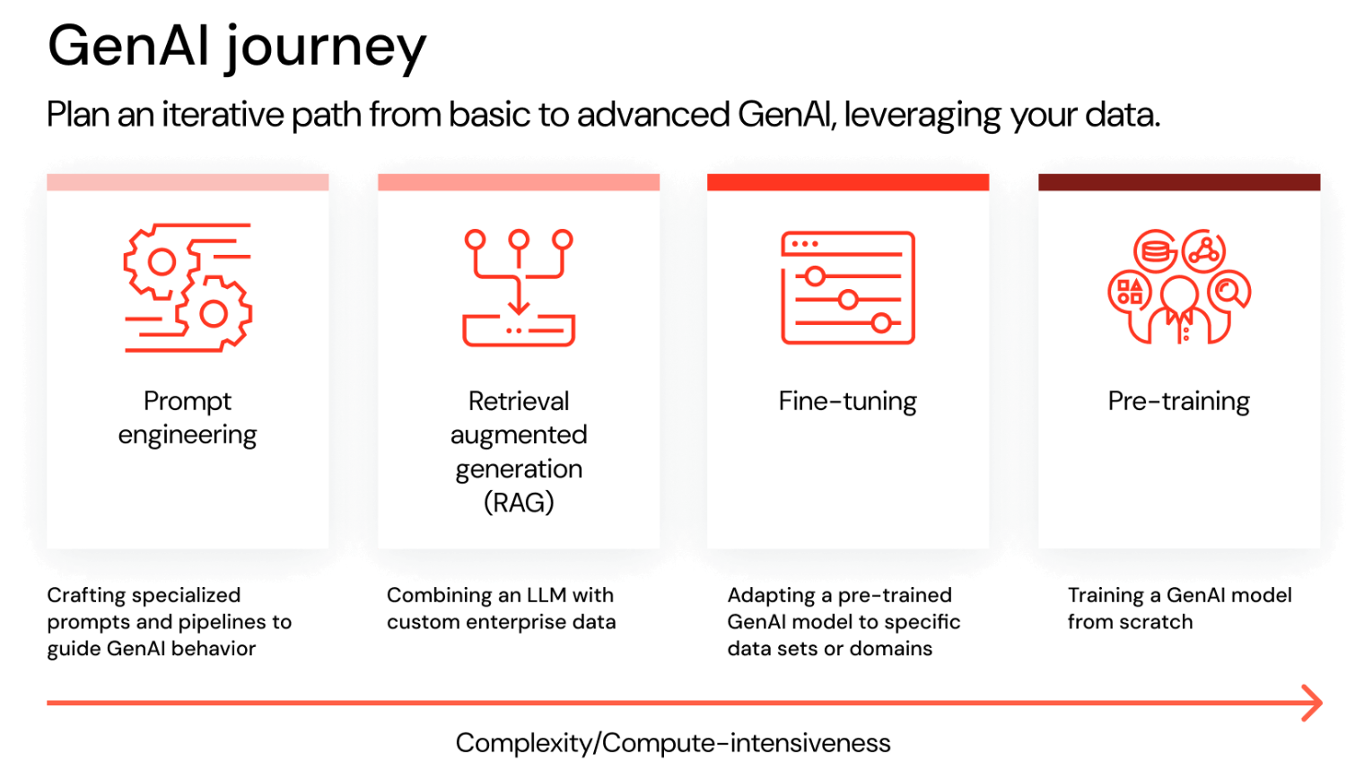
Source: Databricks

Slide 3
Outline
Fine-tuning
Instruction Tuning
Case Study: Multi-label Classification
PEFT
RLHF

Slide 4
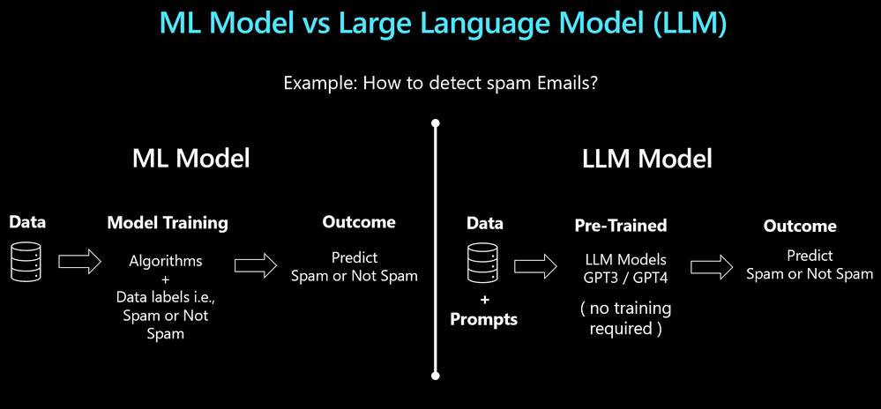
ML vs. LLM
Source: Microsoft

Slide 5
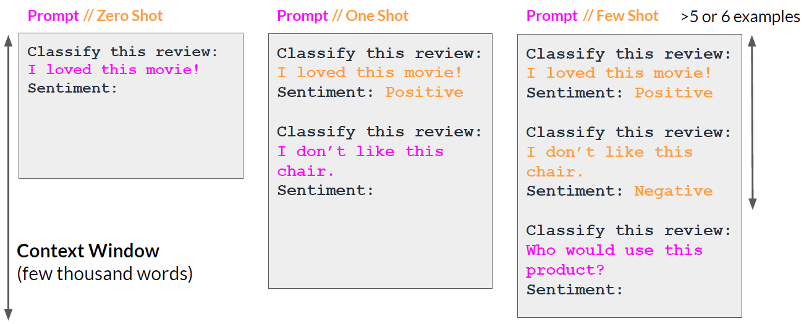
In-context Learning

Slide 6
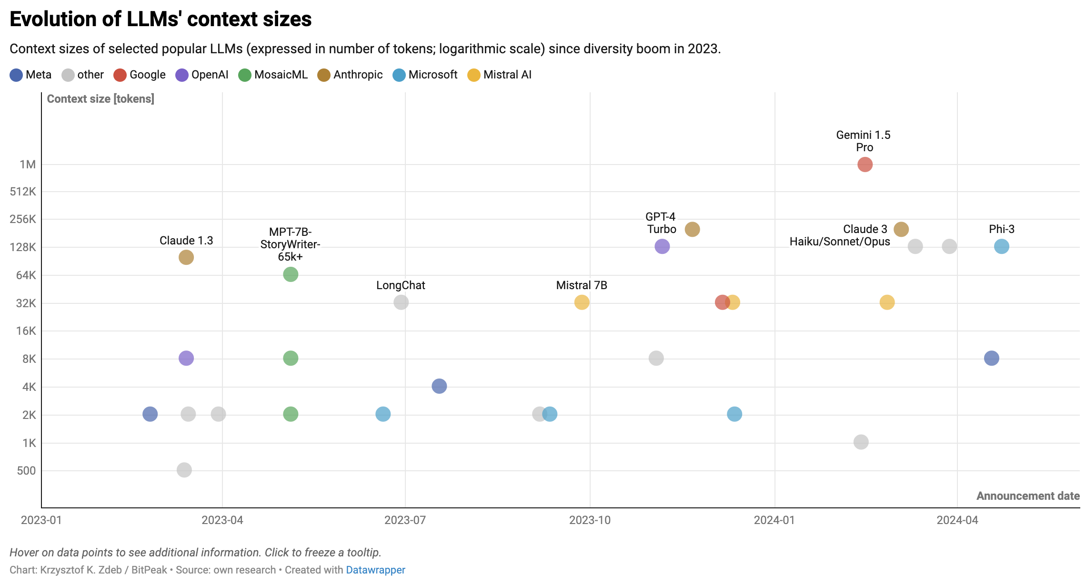
Notes:
https://www.datawrapper.de/_/UyC7R/
https://towardsdatascience.com/towards-infinite-llm-context-windows-e099225abaaf

Slide 7
Fine-tuning
Fine-tuning is a technique used to create a custom model by training an existing foundational model with a dataset of additional training data.
Fine-tuning can result in higher quality requests than prompt engineering alone, customize the model on examples larger than can fit in a prompt, and allow the user to provide fewer examples to get the same high-quality response.
However, the process for fine-tuning is both costly and time intensive and should only be used for use cases where it is necessary.
Notes:
可能多次refine-tunring，造成成本增加

Slide 8
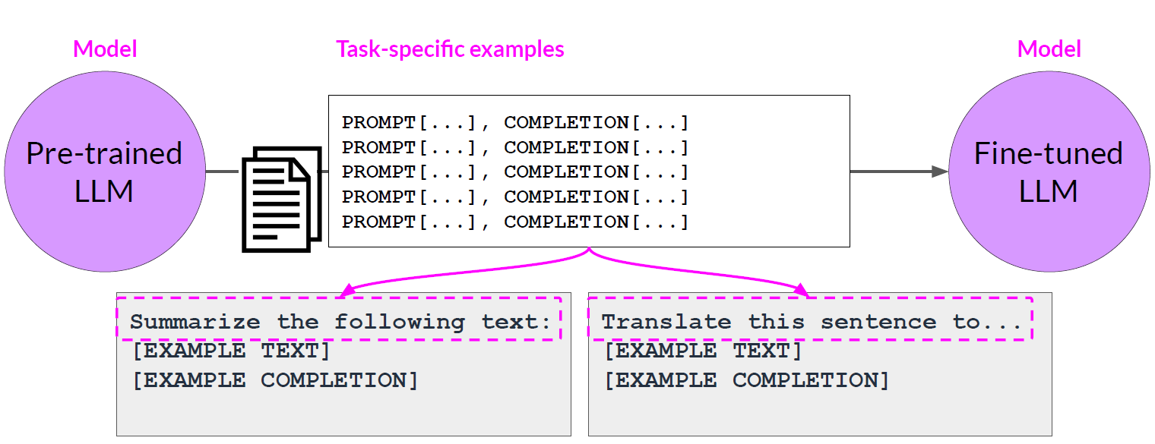
Fine-tuning Large Language Models
Source: DeepLearning.AI / AWS

Slide 9
Why Fine-tuning?
To solve a specific problem
Higher quality results than prompting
Ability to train on more examples than can fit in a prompt
Abundance of high-quality data and ground truth labels
Cost considerations
Token savings due to shorter prompts
More cost effective to use smaller or less capable models
Latency (faster response without long prompts in RAG)
Source: Microsoft / OpenAI

Slide 10
Common use cases
Setting the style, tone, format, or other qualitative aspects
Improving reliability at producing a desired output为考试专门学习
对于特定task可能提高表现性能，但其他领域worse，“偏科”
Correcting failures to follow complex prompts，具有规律的犯错，微调进行避免
Handling many edge cases in specific ways，比如outlier
Performing a new skill or task that’s hard to articulate in a prompt语言描述不清楚（提示词工程）直接展示how to do it
Source: OpenAI

Slide 11
Instruction Tuning
Instruction tuning is a technique used to fine-tune large language models (LLMs) on a dataset of instructional prompts paired with corresponding outputs.
This process enhances the model's ability to follow instructions and perform specific tasks more effectively.
It aims to bridge the gap between the model's pre-training (which focuses on predicting the next word) and the user's need for the model to adhere to specific instructions.

Slide 12
Earlier LLMs
Prompt: Tell me about the weather.
Completion: The weather today is sunny with a high of 75 degrees Fahrenheit. It’s a beautiful day outside, and you might want to consider going for a walk or enjoying some outdoor activities. The sun is shining brightly, and there are no clouds in the sky, making it a perfect day for a picnic or a trip to the park. Remember to wear sunscreen if you plan to be outside for an extended period!
LLM trained by raw data from internet, raw model, raw data, output is random thing
waste token

Slide 13
Instruction-tuned LLMs
Prompt: Tell me about the weather.
Completion: Today’s weather is sunny with a high of 75°F. Perfect for outdoor activities!

Slide 14
Benefits of Instruction Tuning
Conciseness精准: Instruction tuning helps the model understand when to stop and how to deliver information succinctly.
User Experience: By providing clear and direct answers, the model enhances user satisfaction and engagement.
Task Appropriateness: It ensures that the model tailors its responses to the context of the query, avoiding unnecessary elaboration.

Slide 15
Fine-tuning Steps
Prepare and upload training data
Train a new fine-tuned model
Evaluate results and go back to step 1 if needed
Use your fine-tuned model

Slide 16
OpenAI models that can be fine-tuned
gpt-4o-mini (2024-07-18)
gpt-4o (2024-08-06)
gpt-4.1 (2025-04-14)
gpt-4.1-mini (2025-04-14)
gpt-4.1-nano (2025-04-14)
o4-mini (2025-04-16)
gpt-5 (2025-08-07)

Slide 17
Evaluation
Evaluations can be conducted by computers, humans, or a combination of both.
Computer-based evaluation
Fast, cheap, but potentially less accurate/effective
Human-based evaluation
Slow, expensive, but potentially more accurate
LLM-based evals 生成ground truth答案。LLMestimation 跟人类标注对照
不同的指标根据项目选择，specific

Slide 18
Common Similarity Metrics
Algorithm | Description
Longest common substring | Finds the longest common substring between two strings
Longest common subsequence (LCS) | Finds the longest subsequence between two strings, subsequences need not be consecutive
Cosine similarity | Calculates the cosine of the angle between two vectors
Jaro Winkler | Counts the minimum number of steps to transform one string into another
Hamming | Measures the minimum number of substitutions required to transform one string to another
Jaccard | Calculates similarity by dividing the intersection of two strings by the union of those strings
Levenshtein | Calculates similarity by determining the minimum number of single character edits required to transform one string to another

Slide 19
Machine Translation Evaluation Metrics
Algorithm | Description
BLEU | Evaluates the quality of text from machine translation by calculating the overlap of n-grams between a machine translation and a human quality translation
ROUGE | Compares a machine translation to a human created translation using the overlap of n-grams, skip-bigrams, or longest common subsequence
METEOR | Evaluates the quality of text from machine translation by looking at exact matches, matches after stemming, synonyms, paraphrasing, and alignment

Slide 20
Freelancing Service Text Multi-label Classification
Case Study

Slide 21
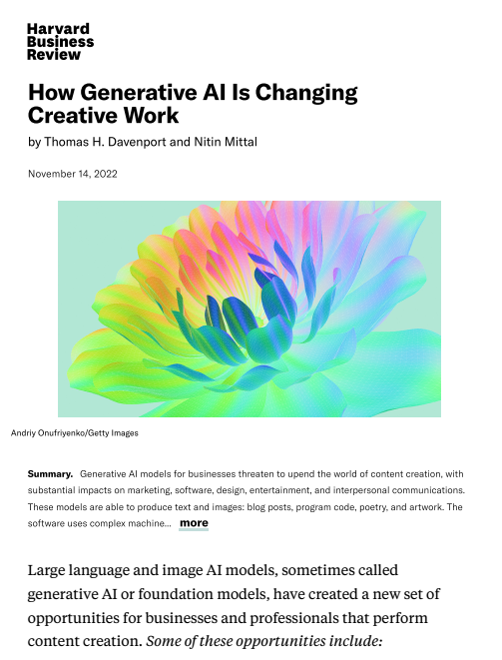
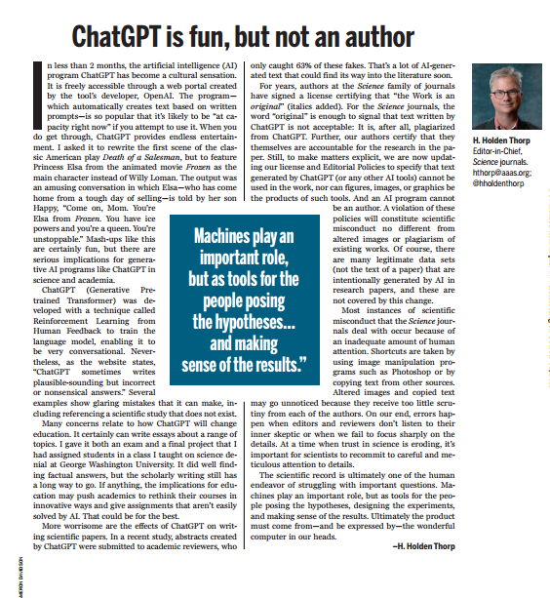

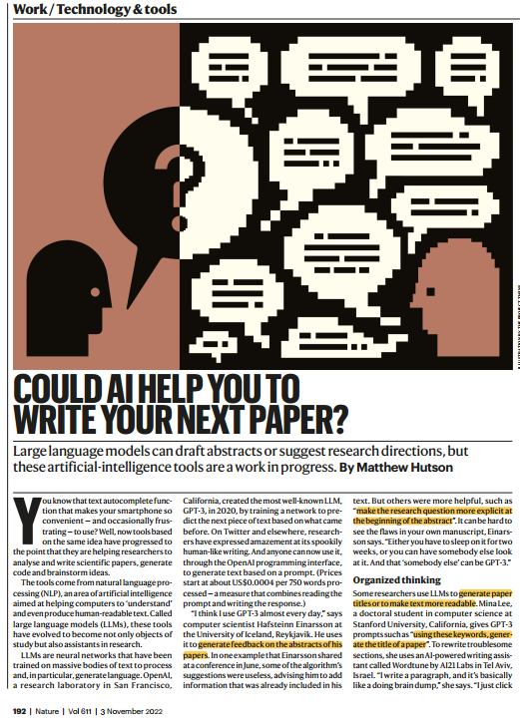
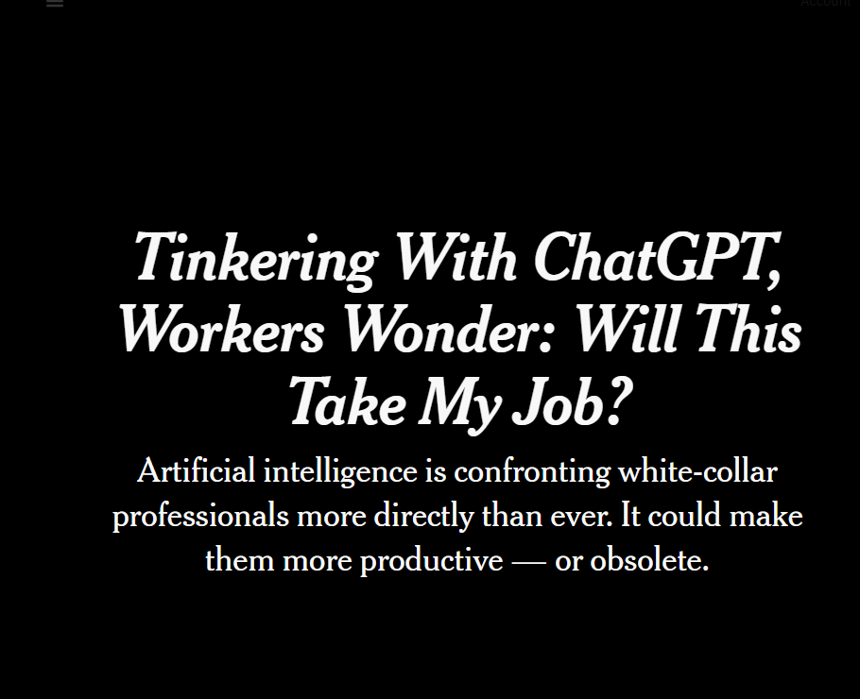
The Impact of ChatGPT
OpenAI released ChatGPT
on Nov 30, 2022.
Notes:
After Nov 30, 2022, ChatGPT and general AI becomes a hot topic by demonstrating the ability of providing high-quality human-like content. It raises serious debates on the potential impact on the labor market, specially among content generation industry

Slide 22
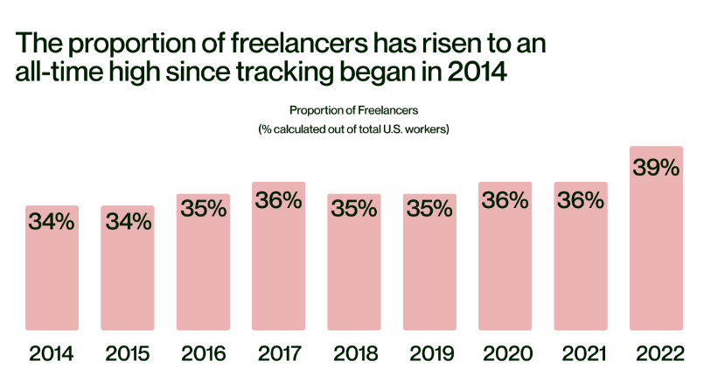
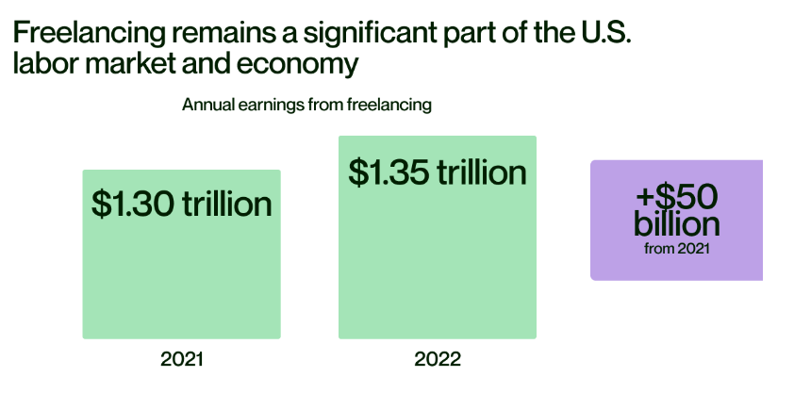
Online Freelance Labor Market
Source from Upwork (Freelance Forward 2022)
Notes:
the online freelance labour market can be a suitable context for understanding the ChatGPT’s impact specially among individual workers.

Slide 23
Three Stages of the Writing Process
Planning
Translating
Editing

Slide 24
Three Stages of the Writing Process
Planning: This stage involves the initial organization, brainstorming, and outlining of ideas. It includes tasks such as idea generation, information gathering, and data collection.
Translating: This stage focuses on expressing ideas and translating them into written form. Tasks within this stage may involve storytelling, writing drafts, and more.
Editing: The editing stage is dedicated to revising and refining written content for clarity, coherence, and correctness.

Slide 25
Datasets
ft_train_validation.xlsx: Training and Validation data for fine-tuning
800 observations in total
Randomly selected 100 observations for each of the eight groups (2×2×2)
700 observations for training and the remaining 100 for validation after shuffling
ft_evaluation.xlsx: Evaluation data after fine-tuning
Randomly selected 500 observations
Comparison between the base (GPT-4o-mini) and fine-tuned models
Notes:
4/21课堂从这里开始

Slide 26

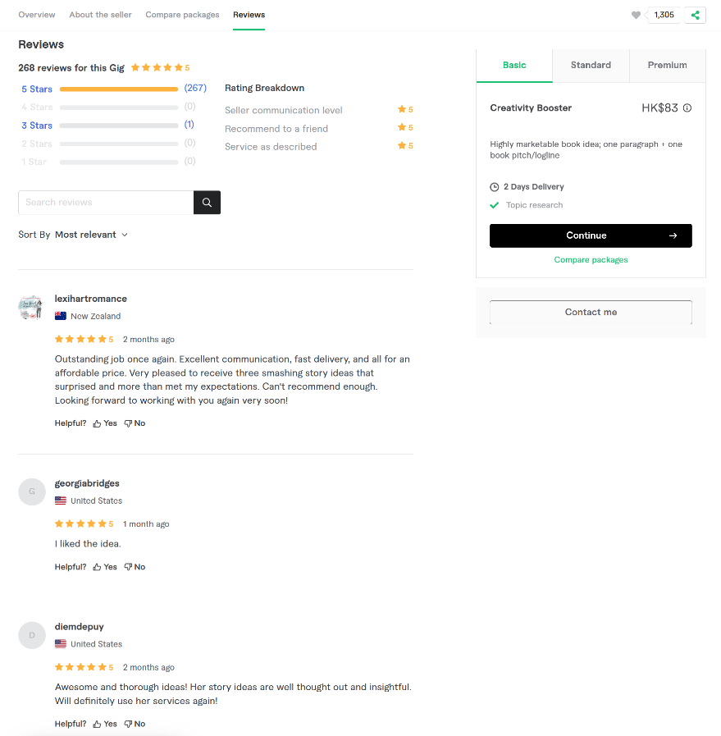
Category\subcategory\nested-subcategory
Title
seller
Average Rating (Total reviews)
Price
Reviewer
Reviewer’s country
Time elapsed between the review date and the data collection date.
Service description

Slide 27
Data Dictionary
service_url: URL of the freelancing service
service_name: Title of the service
description: Description of the service
Planning_4o: Indicator for the Planning stage (1 or 0)
Translating_4o: Indicator for the Translating stage (1 or 0)
Editing_4o: Indicator for the Editing stage (1 or 0)
*_4o:
Generated by the GPT-4o model
Ground truth labels

Slide 28
Ground Truth Labels
prompt=f"""
Analyze the following service text (title + description) and determine if the service covers each of the three stages of the writing process: Planning, Translating, and Editing. Explain your analysis step by step. No need to repeat the input text or the definitions of the stages. For each stage, provide a binary output (1 for yes, 0 for no). At the end of your response, summarize your output in JSON format, e.g., {{"Planning": 1, "Translating": 0, "Editing": 1}}. Definitions: Planning: This stage involves the initial organization, brainstorming, and outlining of ideas. It includes tasks such as idea generation, information gathering, and data collection. Translating: This stage focuses on expressing ideas and translating them into written form. Tasks within this stage may involve storytelling, writing drafts, and more. Editing: The editing stage is dedicated to revising and refining written content for clarity, coherence, and correctness. Service Text: Title: {title} Description: {description} """

Slide 29
Title: I will write website content, faq, about us page, SEO copywriting and all website copy
Description:
PLEASE ALWAYS CONTACT ME BEFORE PLACING YOUR ORDER!
Need content for your "Frequently Asked Questions" (FAQ) or "Help" page(s)? Need an About Us page too?
I will write the content for a clear and concise set of topics defined by you (or agreed together after discussing your requirements). You will then be able to publish the content on your website.
The basic $30 gig applies to one article/section of up to 250 words. Please check my extras for additional options.
I have 15+ years of experience in digital marketing, product management, creating and launching websites and web based products.
Send me a link to your site or app and I will come back with an offer that best suits your requirements!
PLEASE ALWAYS CONTACT ME BEFORE PLACING YOUR ORDER!

Slide 30
### Step-by-Step Analysis:
#### **Planning**
- The service description mentions discussing requirements with the client to define topics. This implies some level of brainstorming and organization of ideas, which aligns with the Planning stage.
- The seller also requests a link to the client’s site or app to tailor the offer, suggesting information gathering and understanding the context before writing.
- These elements indicate that the Planning stage is covered.
**Output for Planning: 1**
#### **Translating**
- The service explicitly states, "I will write the content," which directly corresponds to the Translating stage. Writing content for FAQs, About Us pages, and other website copy involves expressing ideas in written form.
- The description also specifies that the seller will produce content that is "clear and concise," further confirming the act of translating ideas into text.
**Output for Translating: 1**
#### **Editing**
- There is no mention of revising, refining, or improving the written content after the initial draft is created. The service focuses on delivering written content but does not explicitly state that editing or proofreading is included.
- While the seller may produce high-quality content, the absence of any reference to editing tasks means this stage is not explicitly covered.
**Output for Editing: 0**

Slide 31
Python Program: ft.py
generate_training_validation_sets()
preliminary_check()
validate_token_counts()
classify_file("./data/ft_evaluation.xlsx"): for both base and ft models
multi_label_eval("./data/ft_evaluation_gpt-4o-mini.xlsx")
multi_label_eval("./data/ft_evaluation_gpt-4o-mini-ft.xlsx")
Notes:
1. 准备数据集，2. 上传到云端GPU，3. fineturning，4.下载到本地，5.用evaluatation dataset，6. 为什么不直接用这个，作为WPS的插件？

Slide 32
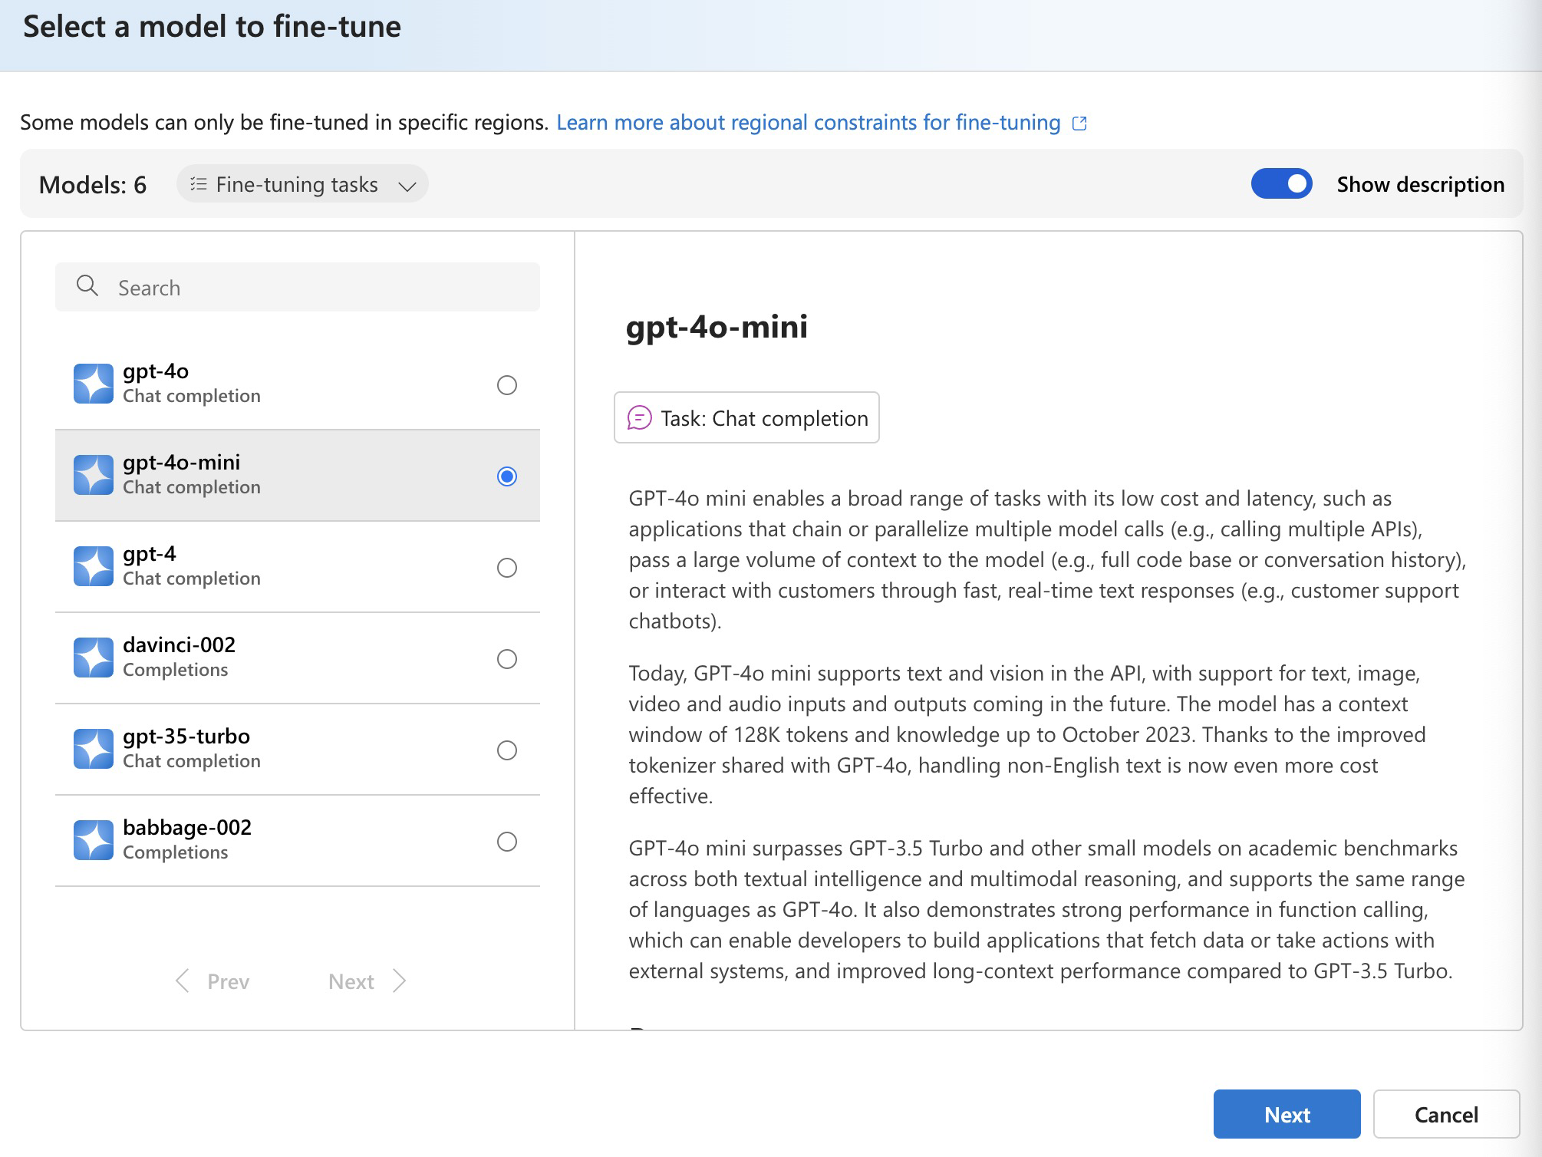

Slide 33
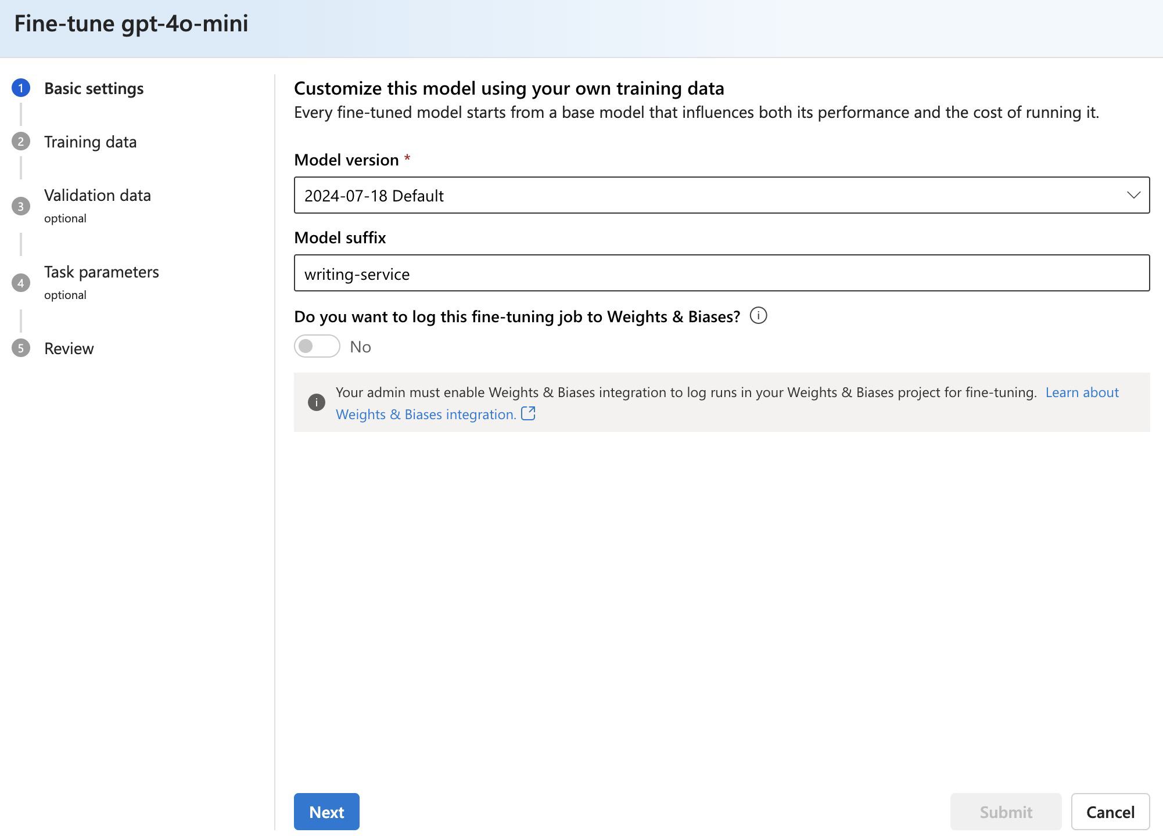

Slide 34
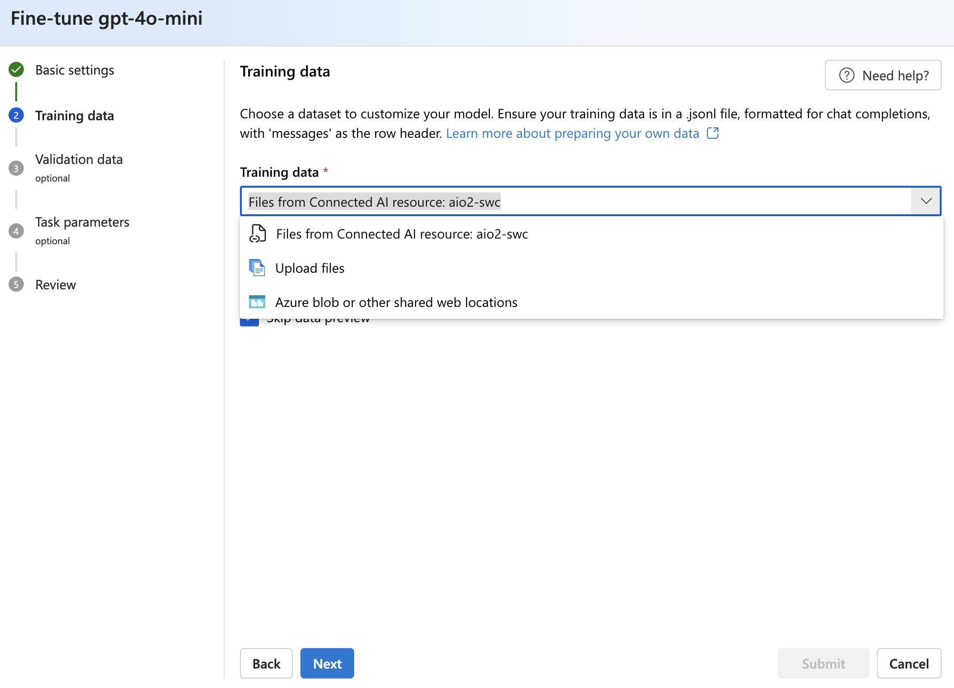

Slide 35
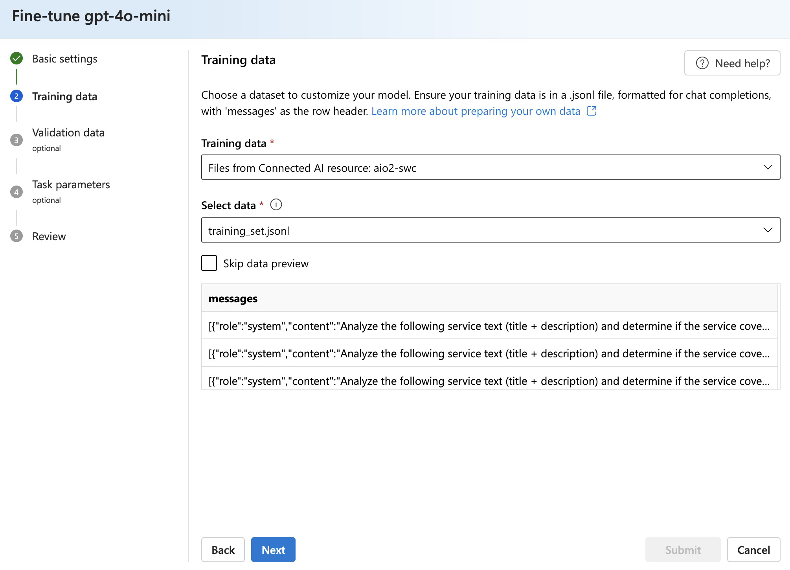

Slide 36
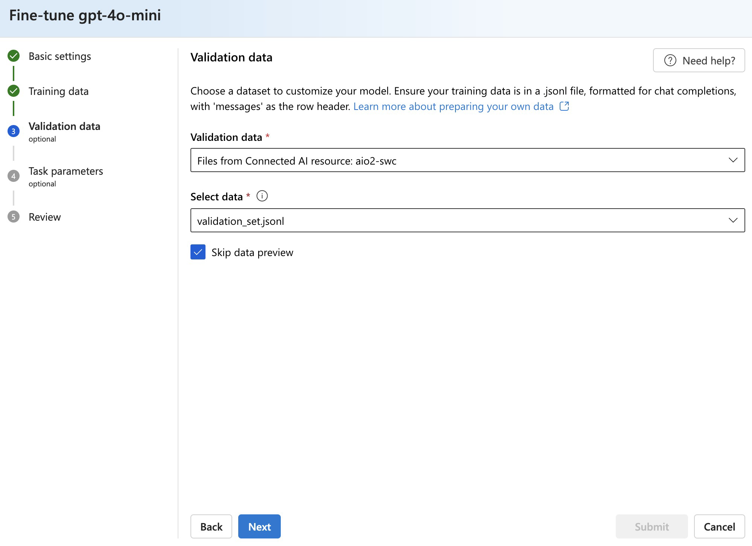

Slide 37
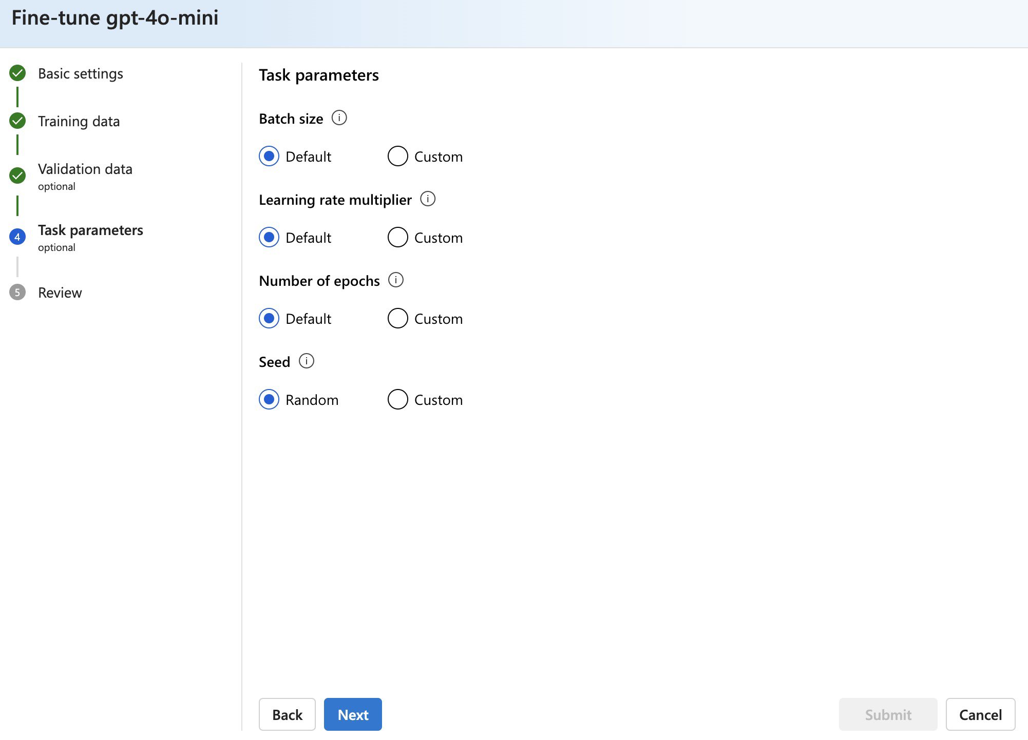

Slide 38
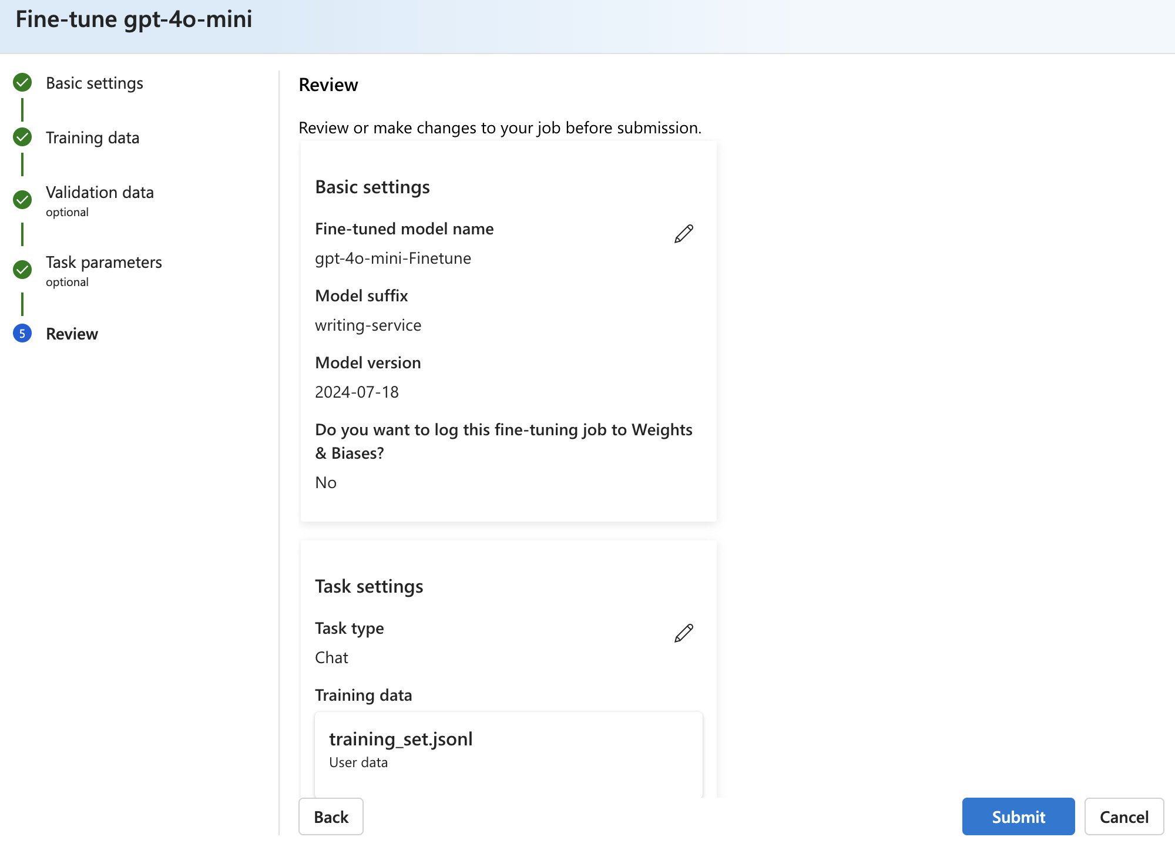

Slide 39
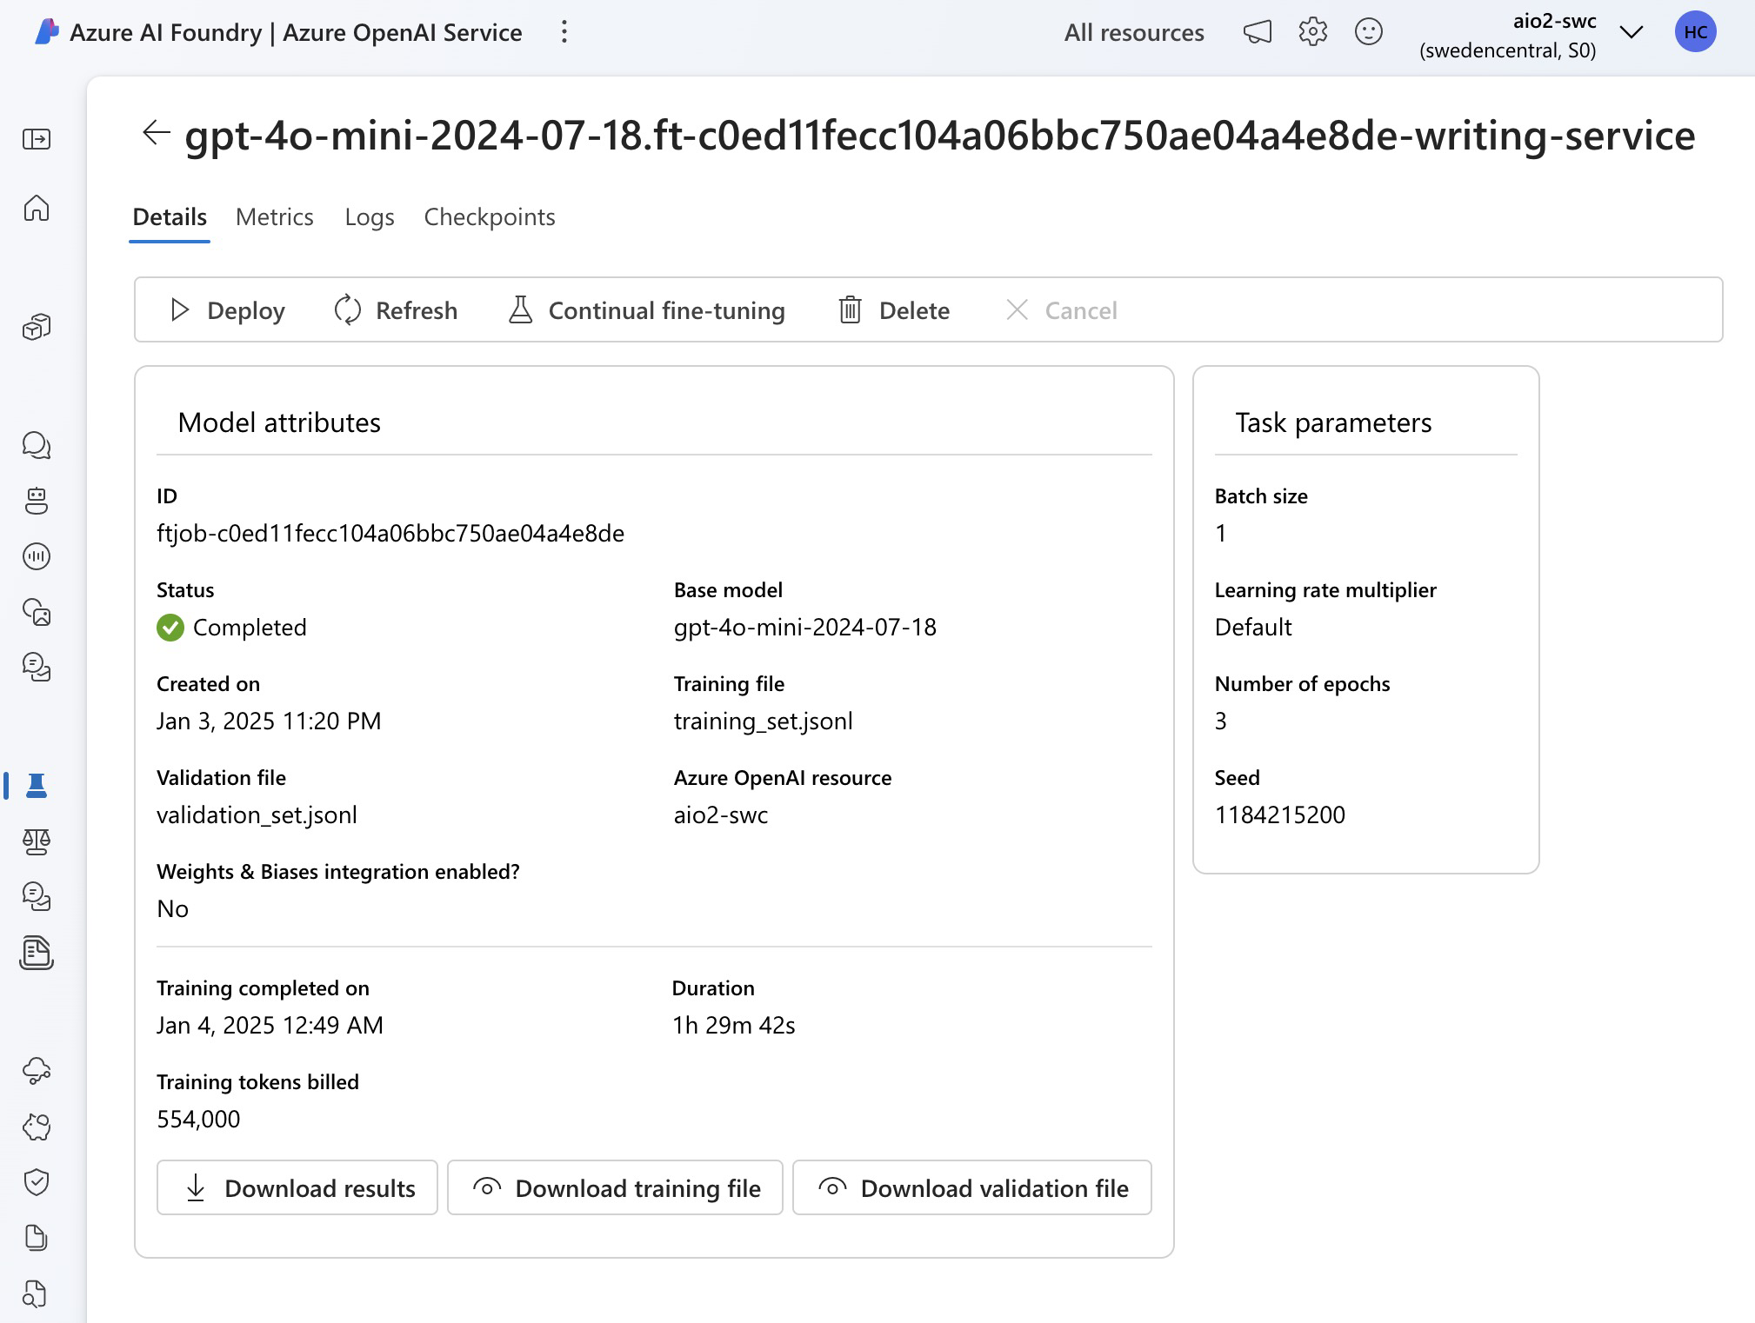

Slide 40
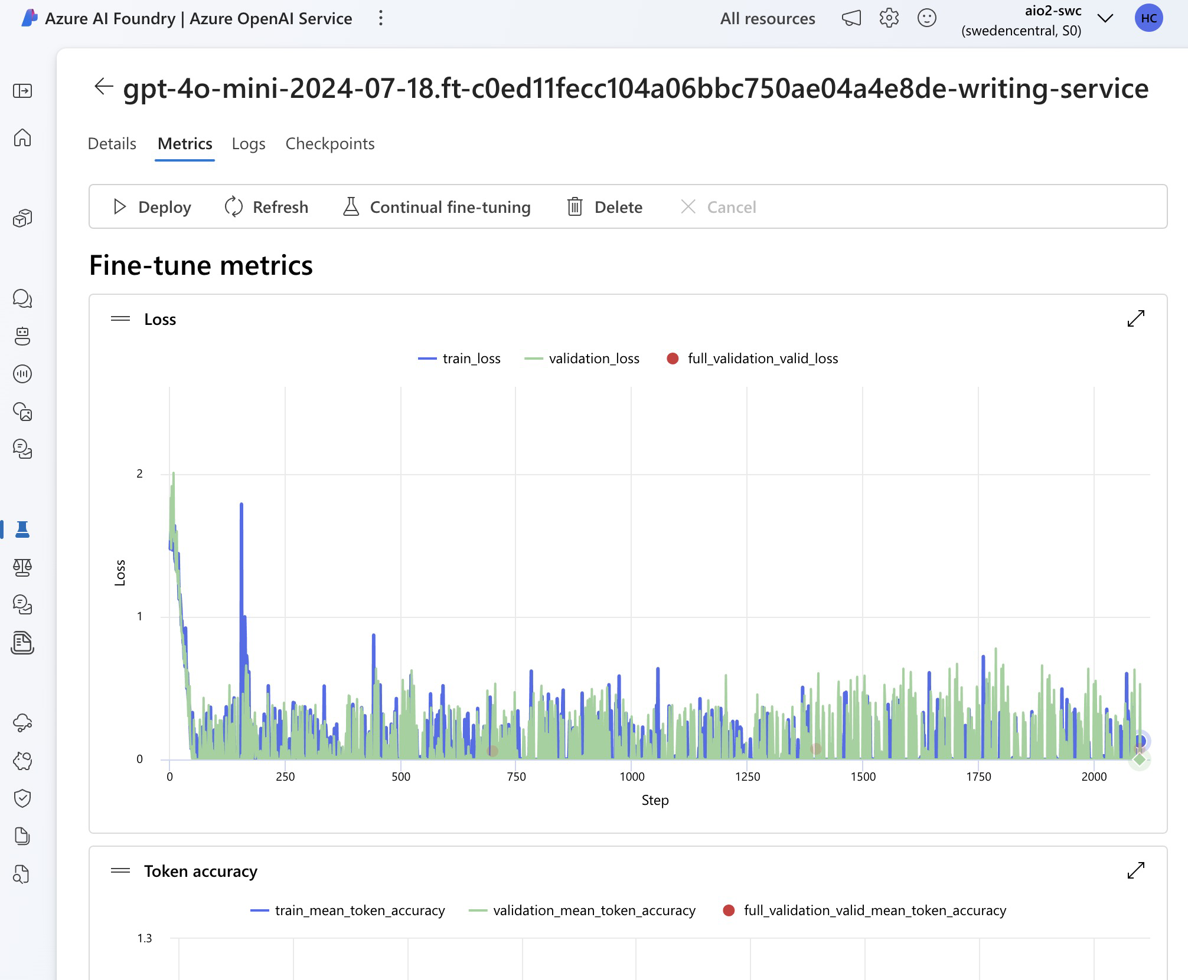

Slide 41
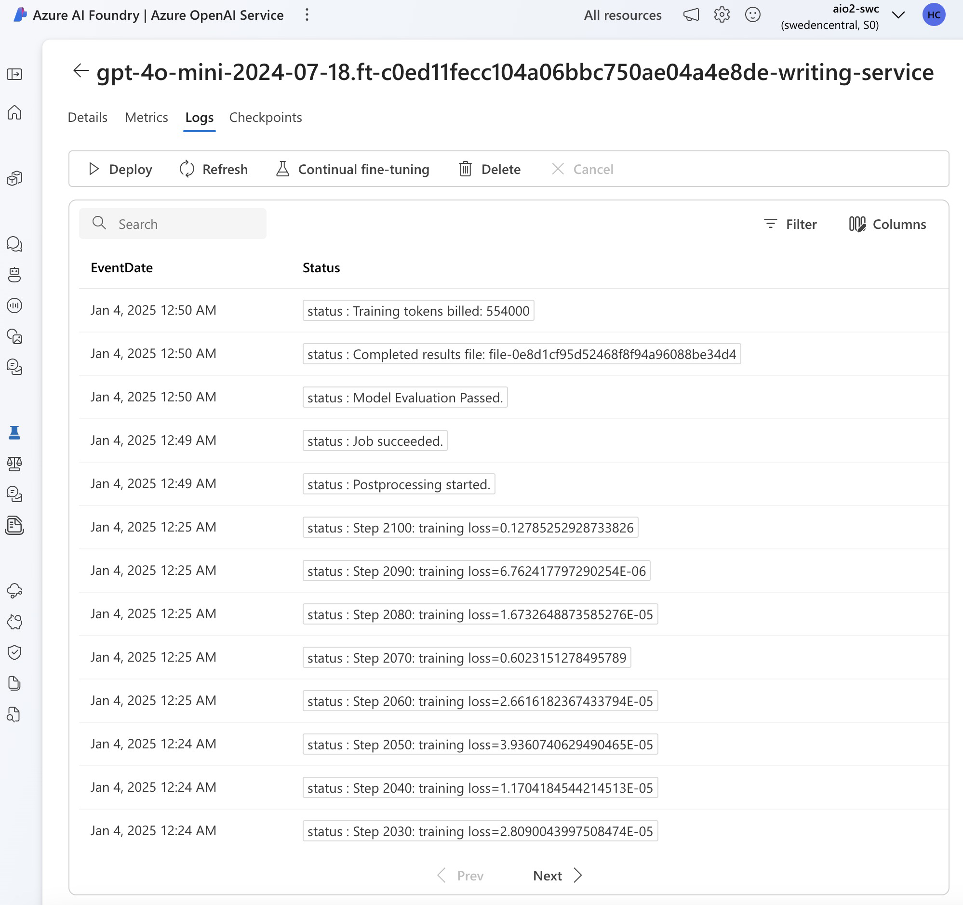

Slide 42
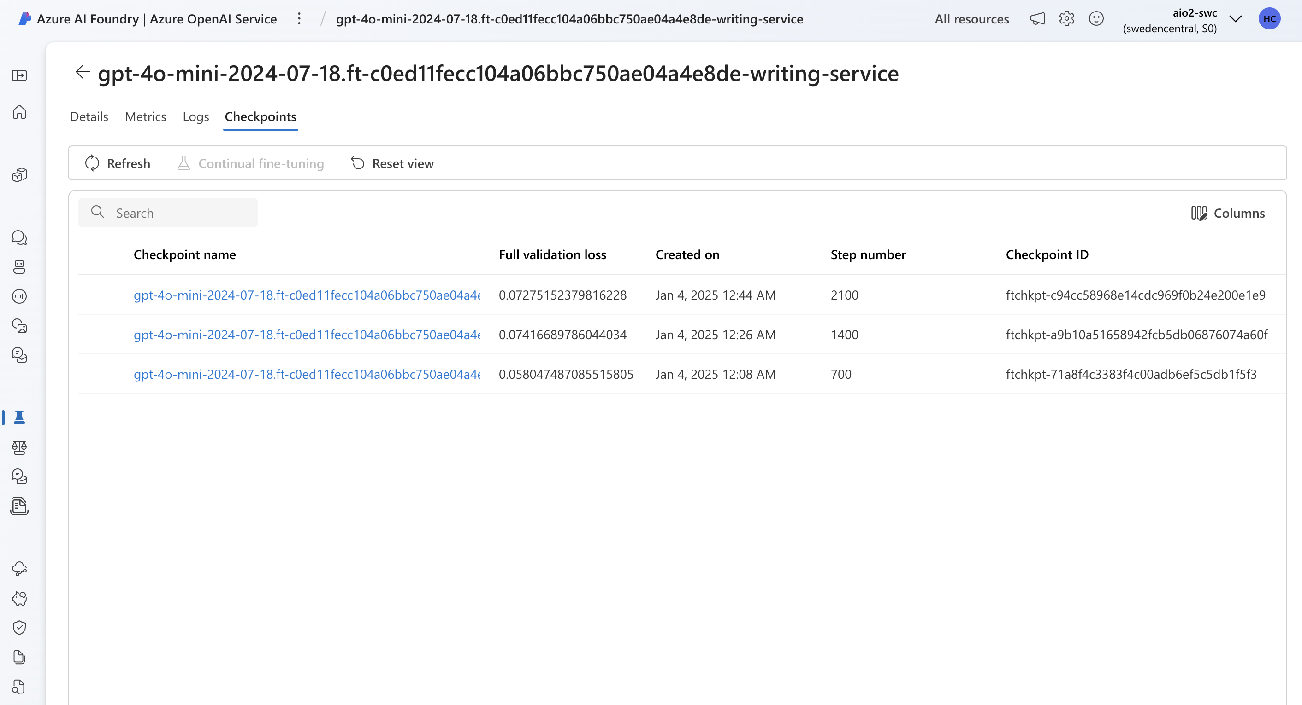

Slide 43
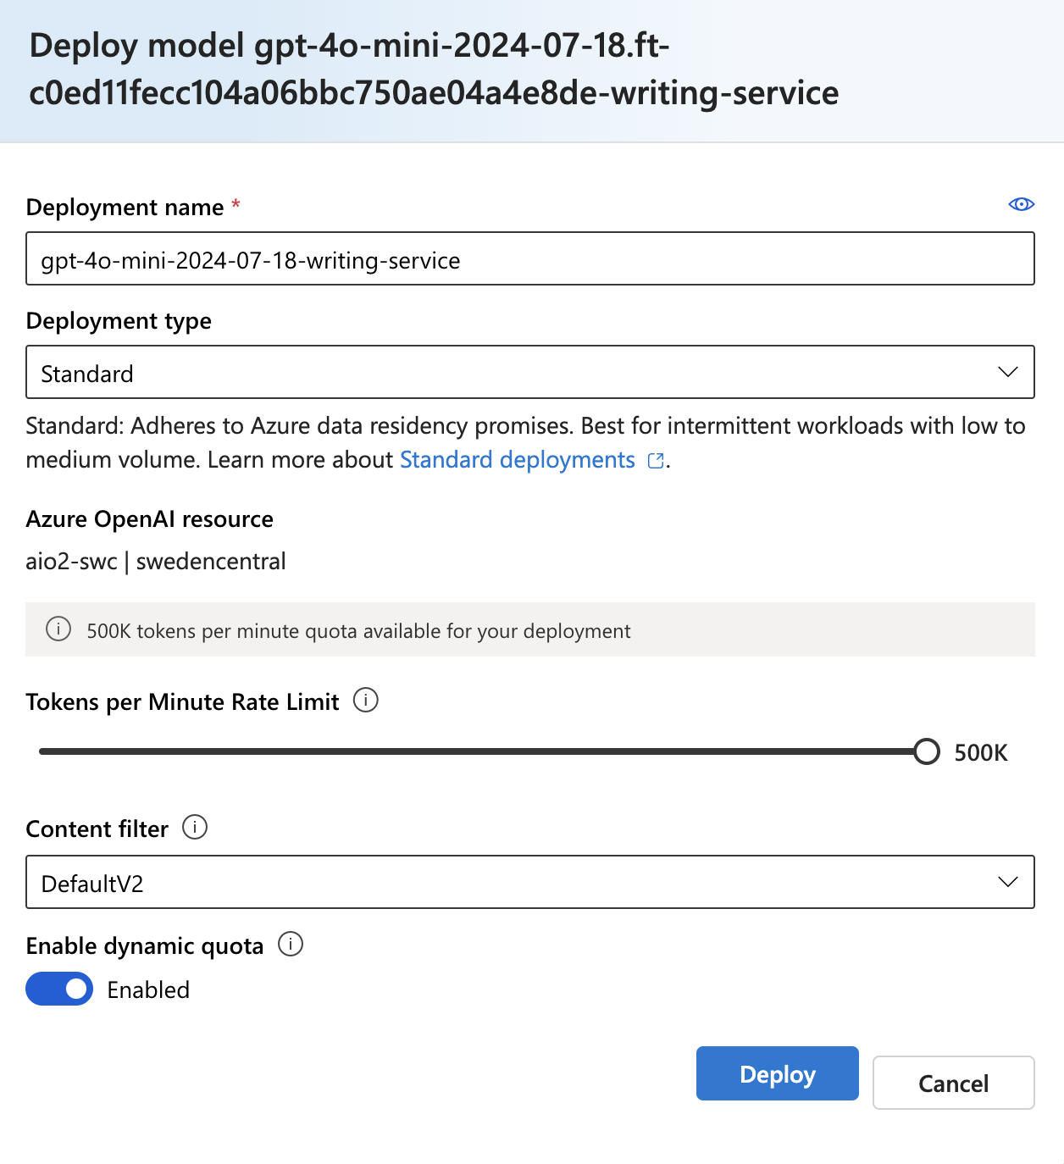

Slide 44
ft_evaluation.xlsx Data Distribution
Planning | Translating | Editing | Count
0 | 0 | 0 | 20
0 | 0 | 1 | 56
0 | 1 | 0 | 148
0 | 1 | 1 | 95
1 | 0 | 0 | 32
1 | 0 | 1 | 8
1 | 1 | 0 | 105
1 | 1 | 1 | 36

Slide 45
Evaluation: Classification Report
Base Model
Fine-Tuned Model
Label | Precision | Recall | F1-Score | Support
Planning | 0.46 | 0.99 | 0.62 | 181
Translating | 0.82 | 1.00 | 0.90 | 384
Editing | 0.51 | 0.99 | 0.68 | 195
Label | Precision | Recall | F1-Score | Support
Planning | 0.81 | 0.90 | 0.85 | 179
Translating | 0.98 | 0.91 | 0.95 | 380
Editing | 0.88 | 0.98 | 0.93 | 194

Slide 46
Evaluation: Multilabel Confusion Matrix
Base Model
Fine-Tuned Model
Label | TN | FP | FN | TP
Planning | 104 | 215 | 1 | 180
Translating | 31 | 85 | 1 | 383
Editing | 122 | 183 | 2 | 193
Label | TN | FP | FN | TP
Planning | 278 | 39 | 18 | 161
Translating | 110 | 6 | 33 | 347
Editing | 277 | 25 | 4 | 190

Slide 47
Catastrophic Forgetting
Catastrophic forgetting occurs when a machine learning model forgets previously learned information upon learning new information. This is particularly problematic in fine-tuning LLMs.
It arises when the model's parameters are updated during fine-tuning. Learning new tasks can overwrite important parameters, leading to a loss of performance on earlier tasks.

Slide 48
How to Avoid Catastrophic Forgetting
Employ frameworks designed for continual learning, which explicitly address the challenge of catastrophic forgetting
Fine-tune on multiple tasks at the same time
Consider Parameter Efficient Fine-tuning (PEFT)

Slide 49
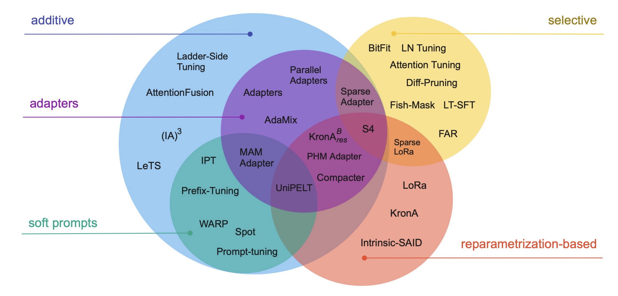
Parameter-Efficient Fine-Tuning Methods
Source: Scaling Down to Scale Up: A Guide to Parameter-Efficient Fine-Tuning

Slide 50
LoRA: Low-Rank Adaptation of LLMs
A technique to fine-tune LLMs efficiently.
It focuses on training a small number of low-rank matrices while keeping the rest of the model frozen.
Intuition:
Reduces the number of trainable parameters, making fine-tuning faster and less resource-intensive.
Preserves the general knowledge of the model while adapting to new tasks.
Effective for scenarios with limited computational resources.

Slide 51
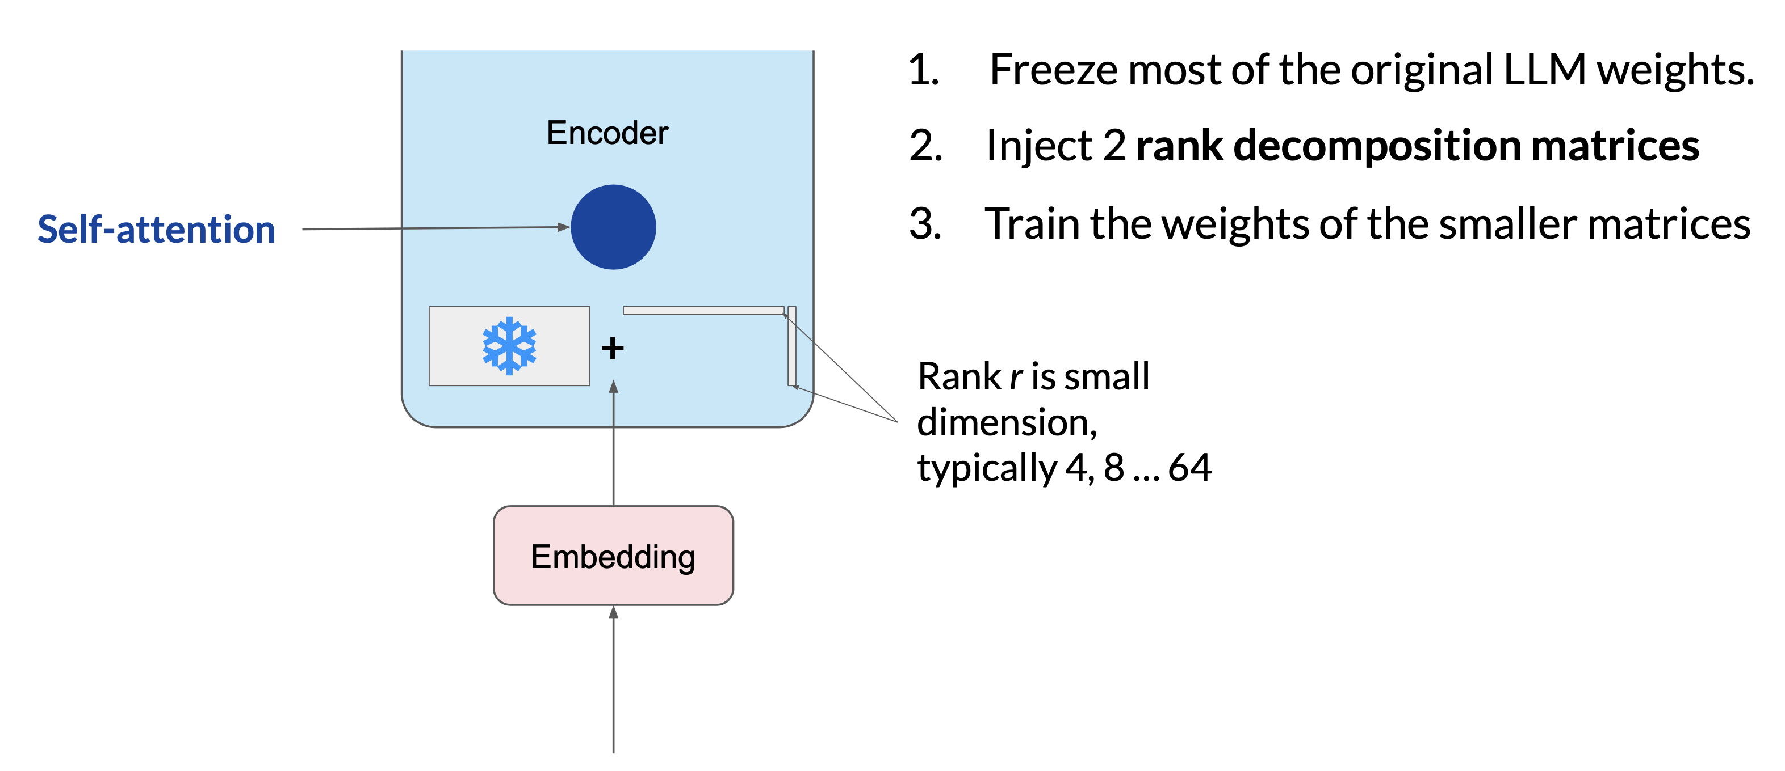
LoRA: Low-Rank Adaptation of LLMs
Source: DeepLearning.AI / AWS

Slide 52
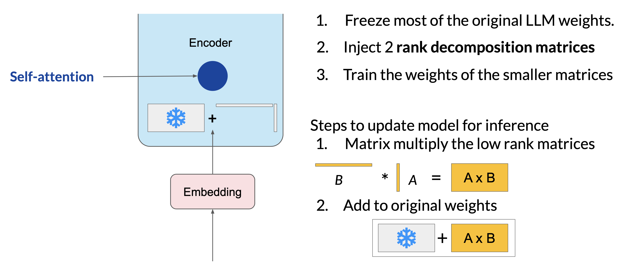
LoRA: Low-Rank Adaptation of LLMs
Source: DeepLearning.AI / AWS

Slide 53
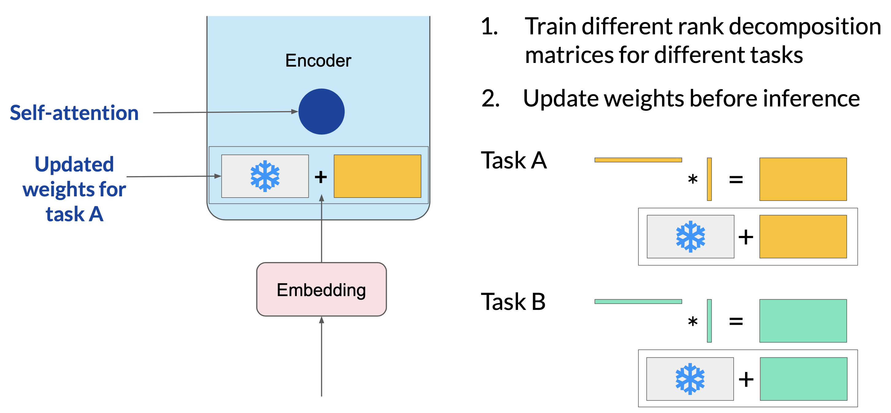
LoRA: Low-Rank Adaptation of LLMs
Source: DeepLearning.AI / AWS

Slide 54
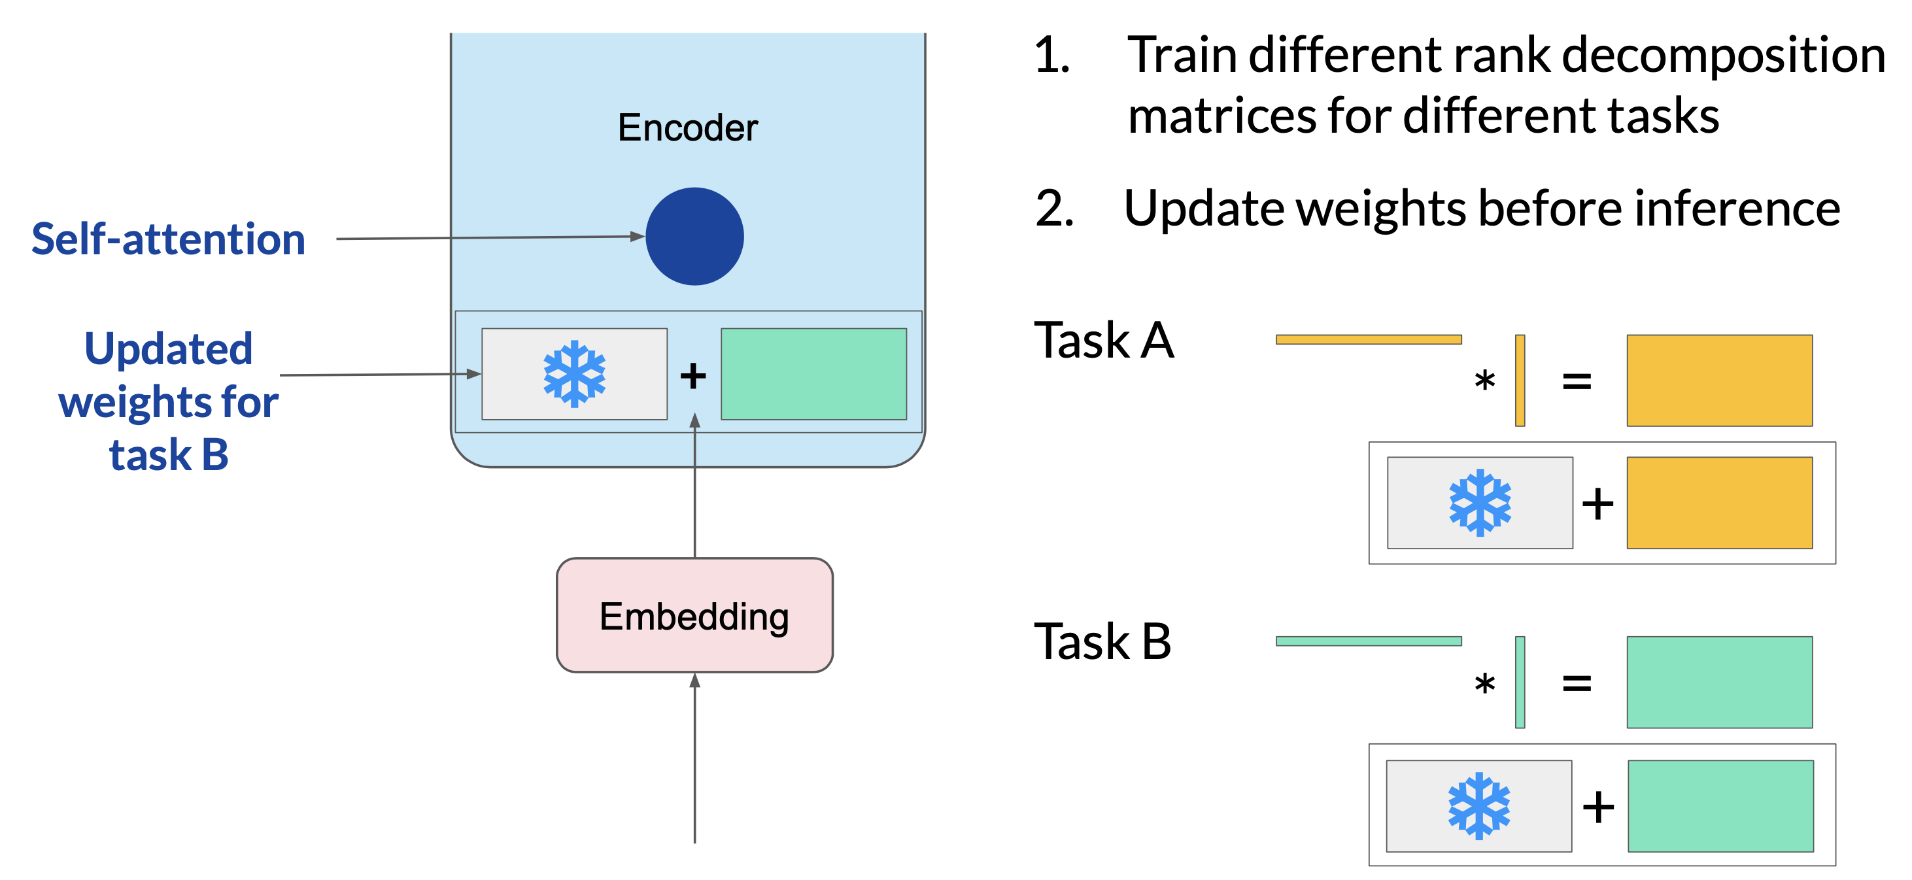
LoRA: Low-Rank Adaptation of LLMs
Source: DeepLearning.AI / AWS

Slide 55
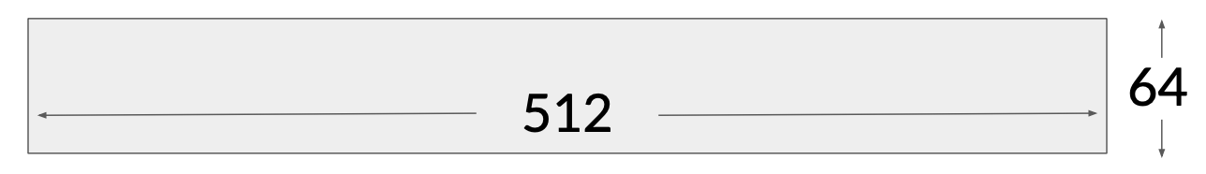
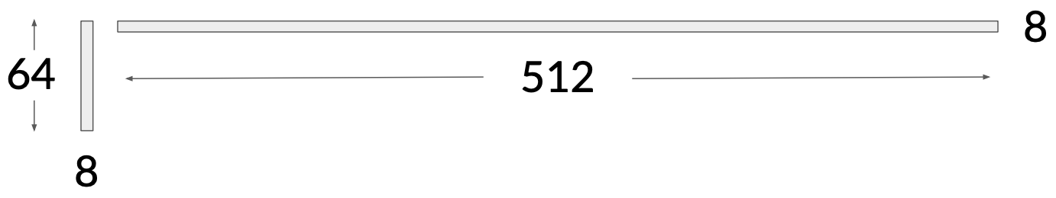
Parameter Reduction
Each attention head has dimensions d x k = 512 x 64
512 x 64 = 32,768 trainable parameters
In LoRA with rank r = 8: 4,608 trainable parameters (86% reduction)
A has dimensions r x k = 8 x 64 = 512 parameters
B has dimension d x r = 512 x 8 = 4,096 trainable parameters
Source: DeepLearning.AI / AWS

Slide 56
Advantages of LoRA
Aspect | Full Fine-tuning | LoRA Fine-tuning
Parameter Reduction | 175B parameters for GPT-3 | 17.5M parameters (1/10,000)
Storage Efficiency | Checkpoint size 1.2 TB for GPT-3 | 35MB
Training Time | Days | Hours

Slide 57
Quantized LoRA (QLoRA)
Combines low-rank adaptation with quantization to reduce model size and computational requirements
Quantization: Reduces the precision of model weights, leading to smaller model size and faster computations.
Effective for deploying LLMs on resource-constrained devices.

Slide 58
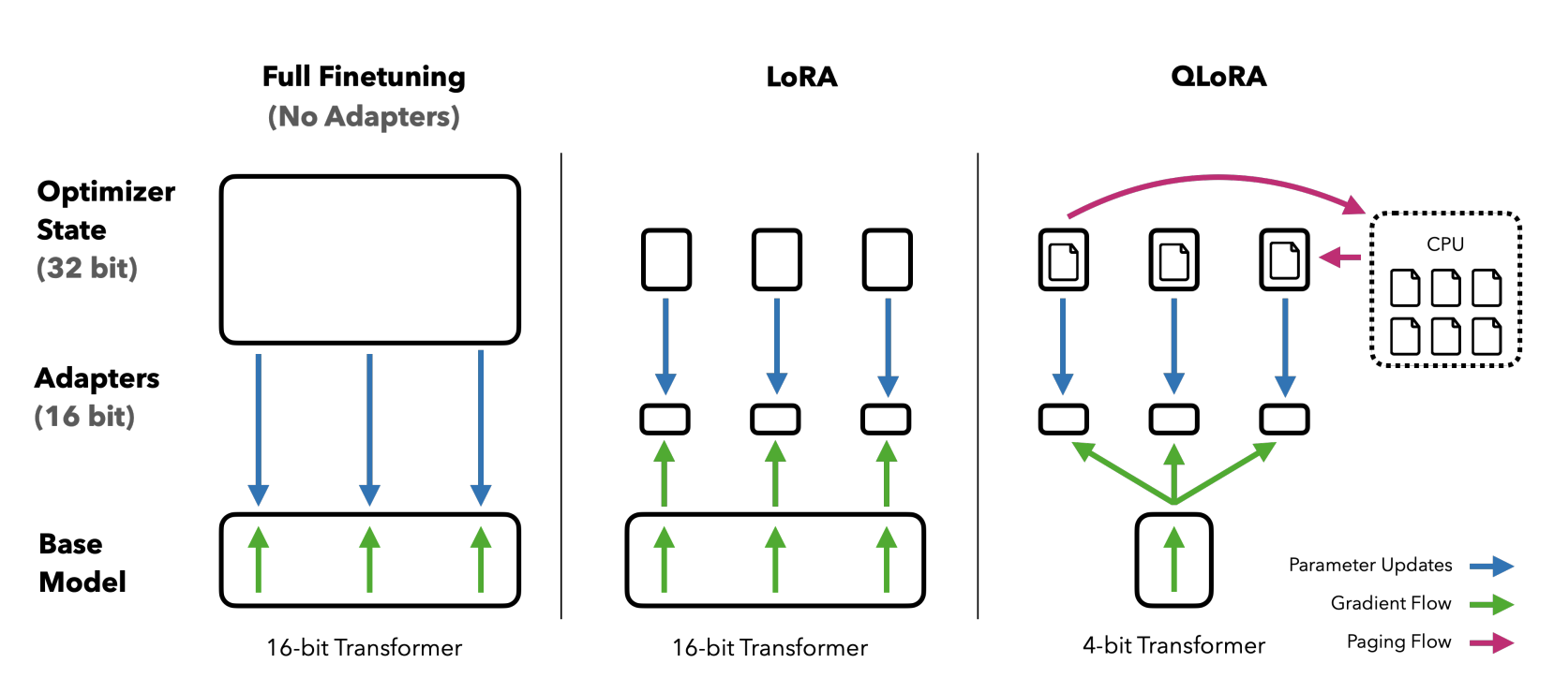
Quantized LoRA (QLoRA)
Source: QLORA: Efficient Finetuning of Quantized LLMs

Slide 59
Prompt Tuning
Prompt Tuning ≠ Prompt Engineering
Prompt tuning focuses on optimizing a small set of prompt tokens instead of updating all model parameters.
Intuition
Prompts guide the model to generate desired outputs.
Efficient and effective for adapting LLMs to new tasks with minimal changes.
Reduces computational cost and preserves the model's general knowledge.

Slide 60
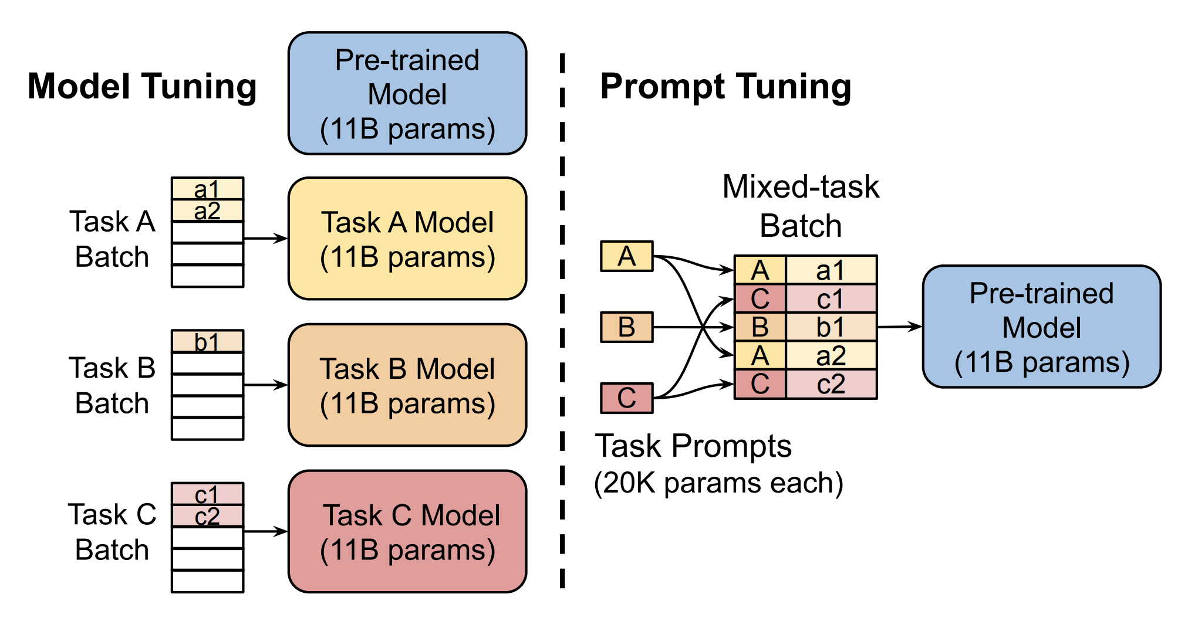
Source: The Power of Scale for Parameter-Efficient Prompt Tuning

Slide 61
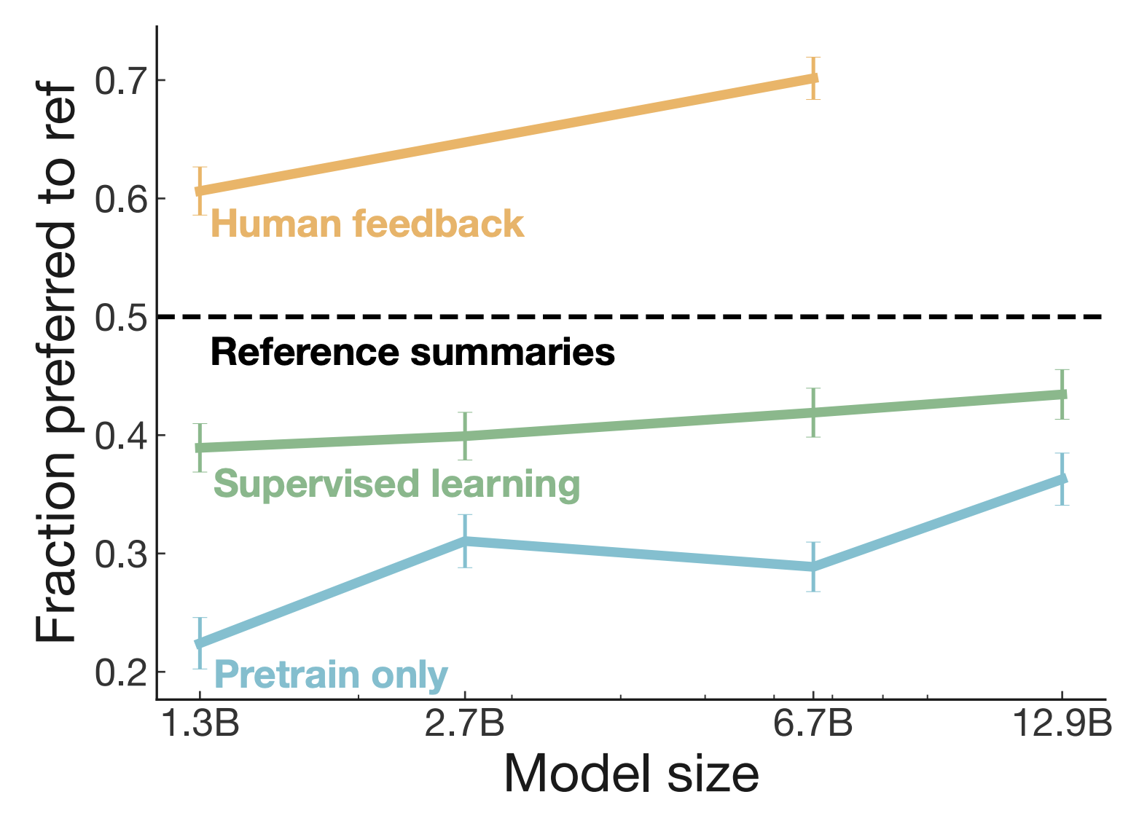
Fine-tuning with human feedback
Source: Learning to summarize from human feedback (2020)

Slide 62
Reinforcement Learning from Human Feedback (RLHF)
A method to align AI models with human preferences and values.
Avoid harmful content
Adapt to diverse cultural norms and values
Provide accurate and useful information
...
Integrates human feedback into the training process.
Enhances model performance and adaptability.

Slide 63
Reinforcement Learning
Agent
state
action
reward
Environment
Examples: Video Games, Go Game, Self-Driving Cars

Slide 64
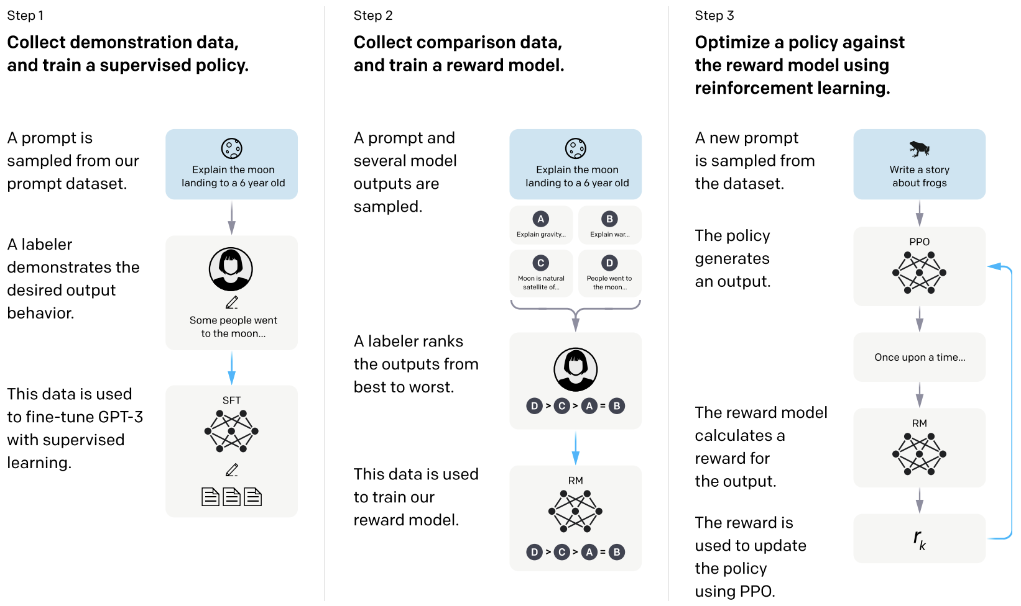
Source: Training language models to follow instructions with human feedback

Slide 65
Use the RM to Fine-tune LLM with RL
Fine-tuned
LLM
Prompt
Dataset
RL
Algorithm
A tree is …
… a provider of shade and shelter.
1.2
Reward
Model
RLHF
Source: DeepLearning.AI / AWS

Slide 66
Use the RM to Fine-tune LLM with RL
Human-aligned
LLM
Prompt
Dataset
RL
Algorithm
A tree is …
… a symbol of strength and resilience.
2.6
Reward
Model
RLHF
Source: DeepLearning.AI / AWS

